Slide 1

Main points:
Team Building
Leader’s Skills
Leadership Styles
Leadership Theories
Team Performance

Slide 2
TEAM
T----Together
E----Everyone
A----Achieves
M----More
Notes:
Writing Strategy: Ask students to list other words or phrases to describe a team or work in groups to develop another acrostic. You may opt to assign a scribe to record all the words or phrases on the board. Lead students to give examples of characteristics cited and to list additional characteristics and practices of an effective team member.
Teacher note: You may opt to create a Wordle “word cloud” from words or phrases the students used to describe a team at www.wordle.net.

Slide 3

Leader is one among all

Slide 4
Team Process
Cohesion
Adjustment
Development
Formation
Reinforcement
Definition
Renewal
Learning
Transformation

Slide 5

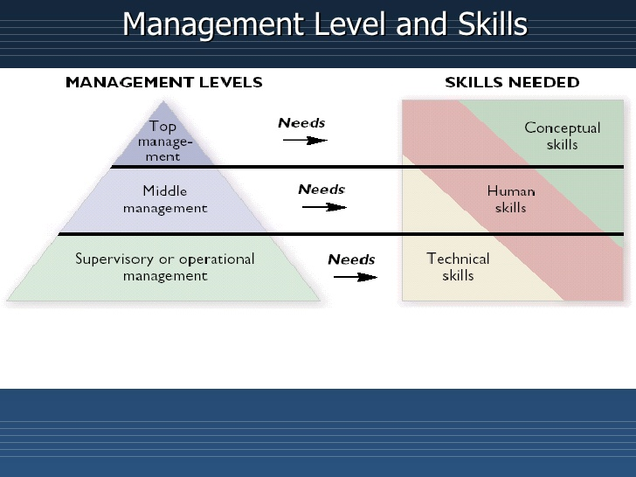


Slide 6
Verbal Behaviors
What behaviors encourage effective participation
Set context
Ask questions of members
Use supportive statements
Seek out different perspectives
Share feelings

Slide 7
Contributor Skills
Initiation - draw out information, clarify ideas
Energize - show enthusiasm, engage in team process, show commitment
Organize
Build relationships
Be flexible
Learn

Slide 8
Human Relations Soft Skills/Transferable Skills
Treating people fairly
Establishing rapport
Being a cooperative team member
Dealing effectively with conflict
Helping clarify misunderstandings
Creating an environment of social interaction
Notes:
These are considered soft skills or transferable skills. These are skills which individuals must develop, refine, practice and reinforce. Why are they called transferable skills? They are called transferable skills because you can transfer them from one situation or career to another. Here is a list of additional transferable skills:
Accepting responsibility
Completing projects on time
Cooperating
Decision-making
Leadership
Management
Negotiating
Patience with difficult people
Problem-solving
Setting priorities
Tactfulness
Can you think of skills you have that you can transfer to many different situations or careers?

Slide 9
Guidelines for Professional Ethics
1
Is it fair?
Does it uphold the values of the organization?
Can I tell my decisions to my
employer, my
family and others?
How would others regard the details if made public?
2
Am I confident in my decision?
Will it be valid for years?
Is it legal?
Will it hurt anyone?
Does it positively represent the company?
3
Does it make anyone uncomfortable?
Does it convey respect for
others?
Have I involved others by
asking their viewpoint?
Notes:
To determine whether a decision or action is based on sound workplace ethics, managers and employees should ask these questions.
Are all these valid questions to keep in mind as an employee? Why or why not?

Slide 10
Adjustment
Revisions of the initial rules and goals
A reality check of what can be accomplished
Tensions usually come up here, must reach consensus, usually about personalities
Breakpoint comes when the team gets mired in discussions about what to do and who should do what...

Slide 11

Development
Cohesion
Reinforcement

Slide 12
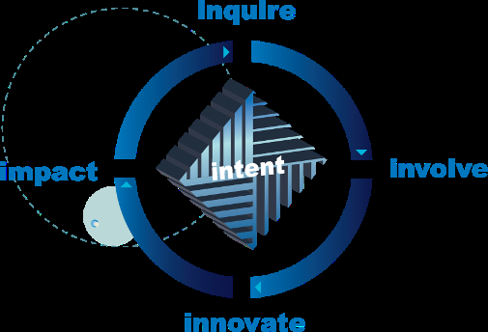
Cohesion
Comes together as a team
High energy
High interest
Progress is made
Team is supportive
Develop relationships

Slide 13
Reinforcement
Cohesion builds
Homogeneity builds
Team members are comfortable with each other
Start to be interested in self-preservation and self-perpetuation
Goals should be on creativity and exploration

Slide 14
Renewal
Learning
Transformation

Slide 15
Learning
Team learns new skills
Build relationships to accomplish task
Commitment and mutual accountability
Now, team may be confrontational over issues

Slide 16
Transformation
Results are produced from team activities
Innovative
To sustain energy, must stress and press the team
Needs new challenges, new members, new tasks, new relationships or…...

Slide 17
Team Culture
Team Values
Team Rituals
Team Learning

Slide 18
Team Rituals
How to add new members
How to provide information to new members
How a member exists
Work rituals
How the team celebrates!

Slide 19
Team Learning
Continuous improvement process
How team resolves conflict
How the team handles diversity
Harness team creativity

Slide 20
TEAMS AND PERFORMANCE
Synergy- two or more individuals working together toward a specific effort
Teams-a group of people linked to a common purpose
In a team setting, members share accountability and responsibility

Slide 21
TEAMS AND PERFORMANCE Types of Teams
Formal: developed within the formal organizational structure
Functional (within a department)
Cross-functional (different departments)
Informal: individuals who get together outside the formal structure
Virtual teams: function through electronic means

Slide 22
TEAMS AND PERFORMANCE Stages of Team Development
FORMING
ADJOURNING
STORMING
PERFORMING
NORMING

Slide 23
TEAMS AND PERFORMANCE Stages of Team Development
Forming stage: getting to know and form initial opinions about team members
Storming stage: some team members begin to have conflict with each other
Norming stage: team members accept each other and overcome the conflict
Performing stage: team works on task
Adjourning stage: team completes task and brings closure to the project

Slide 24
CHARACTERISTICS OF A TEAM MEMBER
Know team goals and objectives
Every activity should contribute to team goals and objectives
Team member characteristics:
Trustworthy
Performer
Efficient
Communicator

Slide 25
CHARACTERISTICS OF A GOOD TEAM MEMBER - Teams & Conflict
Do not make assumptions
If you disagree with the team, voice your opinion and state why
If the team decides to go in a direction other than what you wanted, respect and support the team’s decision

Slide 26
CHARACTERISTICS OF A TEAM MEMBER - The Problem Member
Trust as a foundation
Do not dump work on others
Work around a lazy team member
Team will eventually dismiss a poor performer
Address performance issues in a respectful and diplomatic manner

Slide 27
Brainstorming: a problem-solving method that involves identifying alternatives that allow members to freely add ideas while other members withhold comments on the alternatives

Slide 28

Why work in teams?
We all can learn from each other
Teams can be more effective than individuals when working on complex projects
Teamwork helps develop interpersonal skills

Slide 29
Effective Team Members
Are good communicators
Are reliable
Are respectful of other team members
Cooperate and pitch in to accomplish the goal
Expect success---have a positive, “can do” attitude
Work to find solutions to problems
Notes:
A team member also contributes to the group with the following:
effort
ideas
suggestions
Listens to other team members’ ideas
Provides encouragement to other team members
Resolves differences for the benefit of the team

Slide 30
Not So Effective Team Members
Team members who are not effective are often:
Aggressive
Dominating
Individuals who disrupt the work and/or do not
take the project seriously
Lazy and/or not dependable
Withdrawn and/or afraid to contribute
Notes:
What is the difference between an effective team member and an ineffective team member?
Enrichment activity: Divide the class into groups. Give each group poster paper and markers. Have groups develop a list of items that create a successful team and present their posters to the class. These could be placed in the hall to share with the school.

Slide 31

Leadership

Slide 32
Conceptions of Leadership:
Exercising power.
Gaining and exercising the privileges of high status.
Being the boss.
Task orientation.
Taking care of people.
Empowerment.
Providing moral leadership.
Providing and working toward a vision.

Slide 33
What is leadership style?
Leaders’ styles encompass how they relate to others within and outside the organization, how they view themselves and their position, and—to a large extent—whether or not they are successful as leaders.

Slide 34
How do you determine what is an appropriate style?
Good leaders usually have a style that they consciously use most of the time, but they're not rigid. They change as necessary to deal with whatever comes up.
Be consistent with what people in the organization expect.
Your style needs to be consistent with the goals, mission, and philosophy of your organization.

Slide 35
Analysis of leadership effectiveness
Define and measure some criteria of organizational effectiveness
Assess leadership style of organization’s leaders
Attempt to correlate organizational performance with leadership styles

Slide 36
How important is a leader?
In most cases, people will perform at about 60% of their potential with no leadership at all
Thus, an additional 40% can be realized if effective leadership is available

Slide 37
capability
utilization
40%
Contribution due to leadership
ability of manager
60%
Default contribution due to
need for a job, peer pressure, etc.

Slide 38
The 2 dimensions of management
Economic or productivity-based
“concern for production”
Employee condition and morale
“concern for people”

Slide 39
The 2 dimensions of management
These can also be thought of as:
Initiating structure (get it done)
Consideration (human condition)

Slide 40
Styles of leadership
X
X
Consideration
X
X
X
Initiating structure

Slide 41
Styles of leadership
9
Benevolent
Leader
(Y)
Team
Leader
(Z)
→
concern for
people
Laissez-faire
Leader
(L)
Autocratic
Leader
(X)
1
concern for production →
9

Slide 42
Which style of leadership works best?
Team Leader (Z) has proven to be the most effective in general (9,9)
Requires a “balancing act” of getting things done and having a genuine concern for people

Slide 43
Theory “L”: Laissez-faire leader
Uninvolved - “leave them alone”
Sees main role as passer of information
Lets others make decisions
Basically abdicates responsibility for team or unit

Slide 44
Theory “X”: Autocratic leader
Lacks flexibility
Controlling and demanding
“carrot and stick” approach
Focused solely on productivity

Slide 45
Theory “Y”: Benevolent leader
Very people oriented; encouraging
Organizes around people
Can be paternalistic
“country club” atmosphere: non-competitive

Slide 46
Theory “Z”: Team leader
Balances production and people issues
Builds a working team of employees
Team approach: involves subordinates
Organization is a vehicle for carrying out plans

Slide 47
Results of leadership styles
Theory L: “missing management”
Very low productivity
Theory X: “my way or the highway”
Job stress; low satisfaction; unions form
Theory Y: “country club”
Low achievement; good people leave
Theory Z: “good manager”
High productivity, cooperation, low turnover, employee commitment

Slide 48

Boss versus Leader
Are a boss and leader always the same? Think about a boss, and think about a leader.
Notes:
Have students discuss the difference between someone who just tells everyone what do to and someone who inspires people do to their best. List characteristics of each.

Slide 49
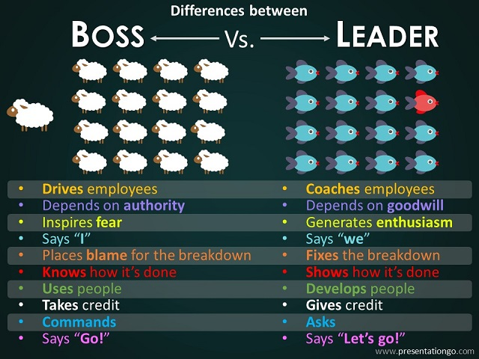

Slide 50
Skills of Effective Leaders
Building and sustaining relationships
Developing and communicating a vision
Influencing people
Making decisions
Overcoming setbacks and adversity
Understanding people’s needs
Notes:
Do you possess these skills as a leader?
You may refer to the full article which provides more of an explanation of these skills at:
Community Tool Box
Core Functions in Leadership
http://ctb.ku.edu/en/table-of-contents/leadership/leadership-functions

Slide 51
Good Leaders Always…
Challenge people to think
Communicate clear expectations
Lead by example
Make decisions
Make others feel safe to speak up
Measure and reward performance
Properly allocate and deploy talent
Provide continuous feedback-positive and negative
Notes:
This link below is to the full article and will provide additional information of the listed characteristics of leaders. Advanced students can be given the link or printed article for extra reading or as an enrichment activity.
Forbes
The Most Successful Leaders Do 15 Things Automatically, Every Day
http://www.forbes.com/sites/glennllopis/2013/02/18/the-most-successful-leaders-do-15-things-automatically-every-day/

Slide 52
Good Leaders Always…
Are accountable to others
Are great teachers
Ask questions and seek counsel
Create a positive, energetic atmosphere
Genuinely enjoy responsibility
Invest in relationships
Problem solve without procrastinating
Notes:
Think about the great leaders of our country or the world. What are some examples of how they exhibit(ed) good leadership skills?

Slide 53
Origins of leadership
Are leaders born or made?
BOTH. Evidence that both inherent personality and environment are factors
What kind of leader would you be?

Slide 54
How do you choose and develop a leadership style?
Start with yourself.
Think about the needs of the organization or initiative.
Observe and learn from other leaders.
Use the research on leadership.
Believe in what you're doing.
Be prepared to change.

Slide 55
Theories of Leadership
Trait theories:
Is there a set of characteristics that determine a good leader?
Personality?
Dominance and personal presence?
Charisma?
Self confidence?
Achievement?
Ability to formulate a clear vision?

Slide 56
Theories of Leadership
Trait theories:
Are such characteristics inherently gender biased?
Do such characteristics produce good leaders?
Is leadership more than just bringing about change?
Does this imply that leaders are born not bred?

Slide 57
Theories of Leadership
Transformational:
Widespread changes
Requires:
Long term strategic planning
Clear objectives
Clear vision
Leading by example – walk the walk
Efficiency of systems and processes

Slide 58
Theories of Leadership
Invitational Leadership:
Improving the atmosphere and message sent out by the organisation
Focus on reducing negative messages sent out through the everyday actions of the business both externally and, crucially, internally
Review internal processes to reduce these
Build relationships and sense of belonging and identity with the organisation – that gets communicated to customers, etc.

Slide 59
Factors Affecting Style
Leadership style may be dependent on various factors:
Risk - decision making and change initiatives based on degree of risk involved
Type of business – creative business or supply driven?
How important change is – change for change’s sake?
Organisational culture – may be long embedded and difficult to change
Nature of the task – needing cooperation? Direction? Structure?

Slide 60
Examples of Balance Paradoxes are not easy to balance. Here are a few examples…
Great Enough to be Without Pride
Team gets the credit, you get the blame
Compassionate Enough to Discipline
Must not be soft – set high expectations and follow through
Right Enough to Say, “I’m Wrong”
Leaders make mistakes too, admit you are human
Wise Enough to Admit You Don’t Know
Find out quickly, but do not mislead
Busy Enough to Listen
Beware the busy manager – they do not lead

Slide 61
MOTIVATION
Motivation: an internal drive that causes people to behave in a certain way to meet a need
Motivation comes from within
There are several factors that contribute to motivation (not just monetary)

Slide 62
MOTIVATION
Maslow in the Workplace
Self-actualization—Expand Skills
Esteem—Recognition/Respect
Social—Informal Groups
Safety—Job Security/Environment
Physiological—Basic Wages

